Slide 1
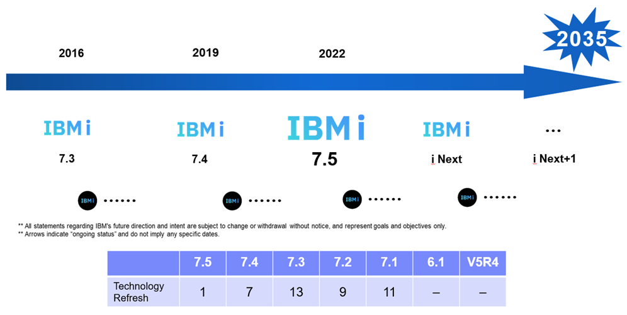
La roadmap IBM i
Link IBM di approfondimento:
https://www.ibm.com/it-it/products/ibm-i
https://www.ibm.com/docs/en/announcements

