Slide 1
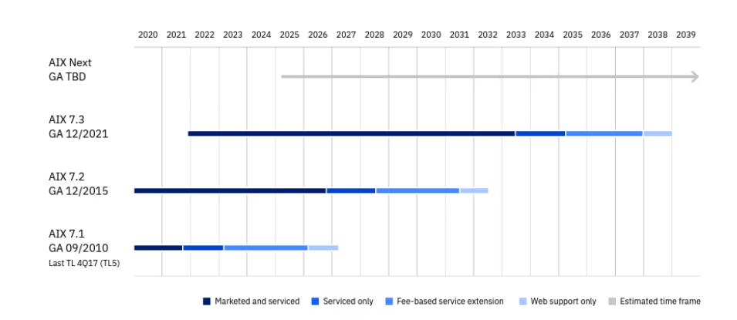
La roadmap IBM AIX
Link IBM di approfondimento:
https://www.ibm.com/it-it/products/aix
https://www.ibm.com/account/reg/it-it/subscribe?formid=urx-39826

